Slide 1

N-GRAM
PERMASALAHAN 2
Kelompok B-4
- Raka Noorsyach (13218040)
- Kevin Naoko (13218046)
- Ian Azarya Aryanto (13218055)
- Andy Lucky (13218058)

Slide 2

Today's Presentation
DISCUSSION POINTS
Permasalahan
Algoritma dan Struktur Data
Struktur File Program dalam Repository
Pengujian Program
Kesulitan yang dihadapi
Kontribusi Anggota
Kesimpulan dan Saran
DEMO

Slide 3
DESKRIPSI
PERMASALAHAN
ANALISIS

Slide 4
ALGORITMA
ALGORITMA DAN STRUKTUR DATA
STRUKTUR DATA
FLOWCHART

Slide 5
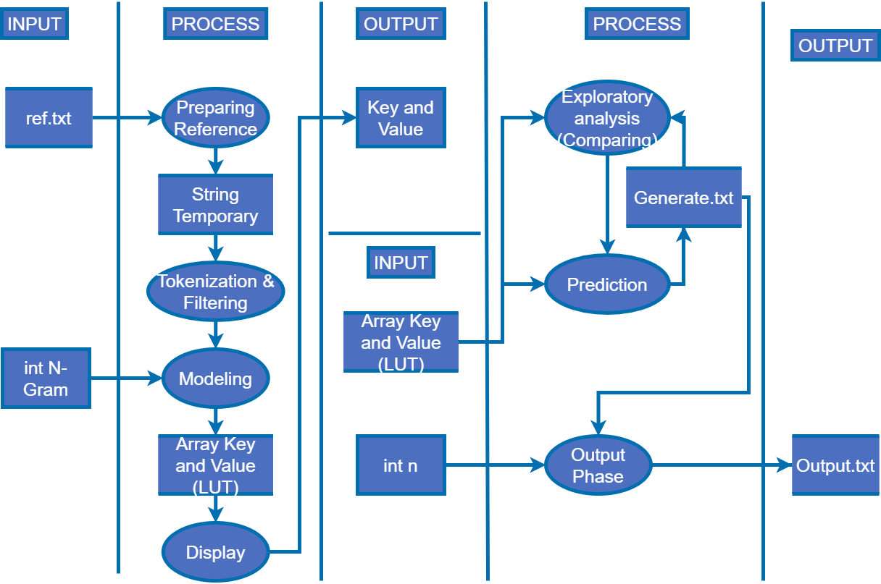

Slide 6

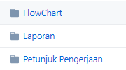
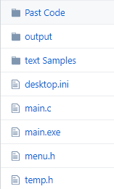
STRUKTUR FILE PADA REPOSITORI
LINK : HTTPS://GITHUB.COM/LUCRANIX28/TUBES2208B4

Slide 7
PENGUJIAN

Slide 8
KESIMPULAN DAN SARAN

Slide 9


KELOMPOK B4
RAKA NOORSYACH
KEVIN NAOKO
IAN AZARYA ARYANTO
ANDY LUCKY
(13218046)
(13218058)
(13218040)
Presentations are communication tools.
(13218055)
Presentations are communication tools.
Presentations are communication tools.
Presentations are communication tools.

Slide 10
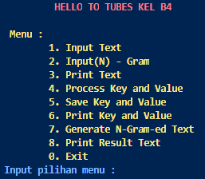
DEMO

